Slide 1
WCS Prices
Timothy Lau 1444107
ECON 493

Slide 2
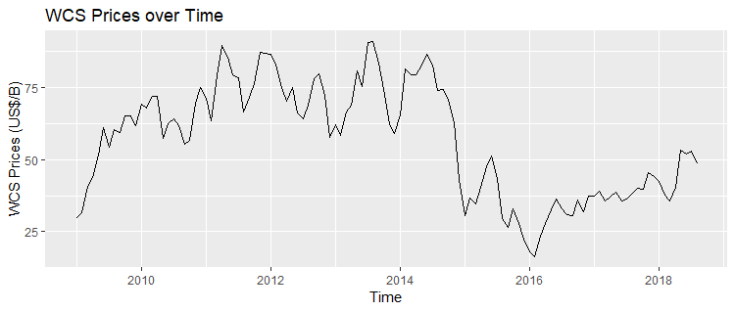
Time Series
Notes:
This paper will utilize dynamic regression model (DRM) techniques to forecast WCS prices.
Western Canadian Select; the variable being forecasted, WCS is the Canadian pricing benchmark for heavy crude oil.

Slide 3
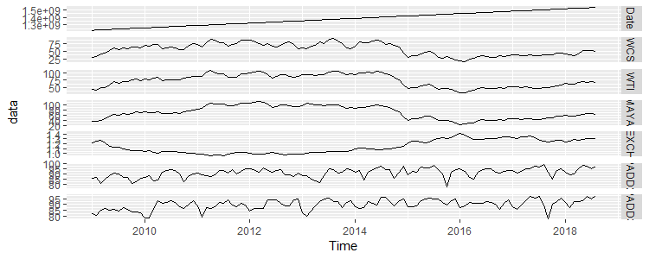
Data
DRM w ARIMA errors
WTI and MAYA
EXCH
PADDII & III
Utilization of refinery operational capacity
US imports
Notes:
Modelling the price of WCS requires consideration of several key factors. Even though WCS has been a benchmark for Canadian crude since 2004, many still price WCS as a differential to WTI – the benchmark for US crude – as well as Mexican MAYA – the global benchmark for crude. This is often attributed to the fact that, because of Alberta’s landlocked nature, 99% of Canadian crude exports go to the US. As such, the pricing of WCS depends heavily on these international price criterions. Another component important to modelling WCS is the strength of the economy relative to its trade partners. Because Canada practically exports exclusively to the US, the exchange rate between the two can be used as a proxy variable for economy strength. Economically, it is important to consider demand for a good when modelling its price. To model the demand for Canadian crude, proxy variables will once again be used. A large bulk of the crude the US imports from Canada are sent to PADDs II and III for refinery; as such, the utilization of refinery operational of these two PADDs’ capacity – which models capacity constraints – as well as the amount of crude the US imports, will be taken into account for the model

Slide 4
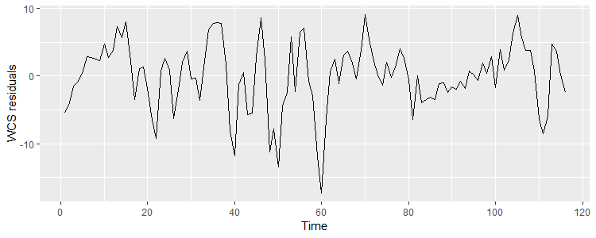
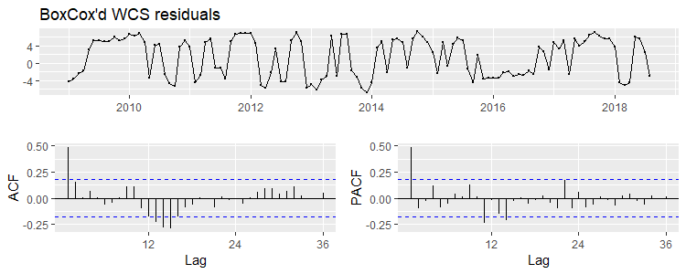
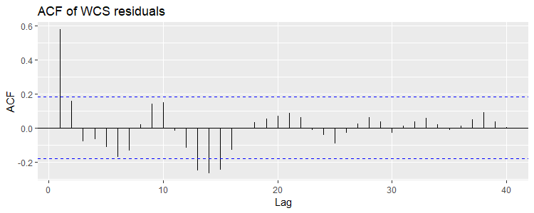
Post regression residuals
Notes:
Regular residuals look somewhat like WN but not enough
So transform the residuals
Residual ACF PACF look like some AR model, possibly AR(1) or ARMA(1,1)
Auto-ARIMA suggests AR(1)

Slide 5
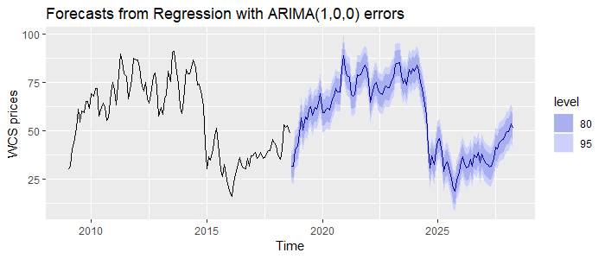
Forecasts
Notes:
Forecasts are just a copy of the history of the data regardless of commands --> suggests useless forecasts
Taking difference of all data and forecasting nets us ARMA(0,0)

Slide 6
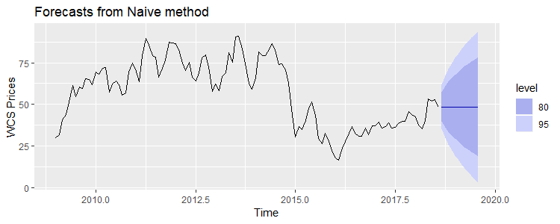
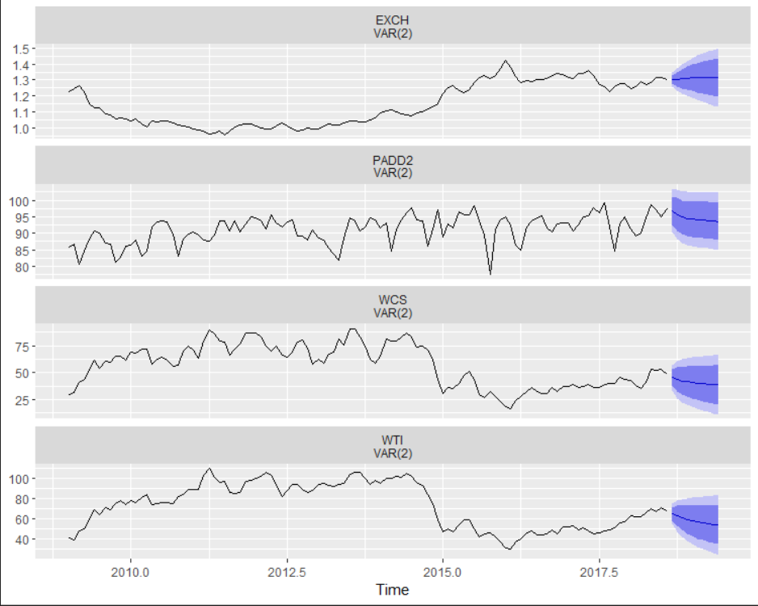
Alternatives
Naïve method
Not very interesting
Not very realistic
VAR

